Slide 1

Overcoming Impostor Syndrome
-> based on the Ada Initiative workshop http://adainitiative.org CC BY-SA <-
A. Rosa Castillo
@rosacastilloPhD
www.linkedin.com/in/arosacastillo

Slide 2


WORKSHOP AGENDA
15 min: Introduction & co.
25 min: Understanding the impostor syndrome
15 min: “Take a compliment” exercise
1 min: Homework: “Combating negative thoughts” exercise
05 min: Wrap-up
Goal: to identify and to deal with the impostor syndrome.

Slide 3
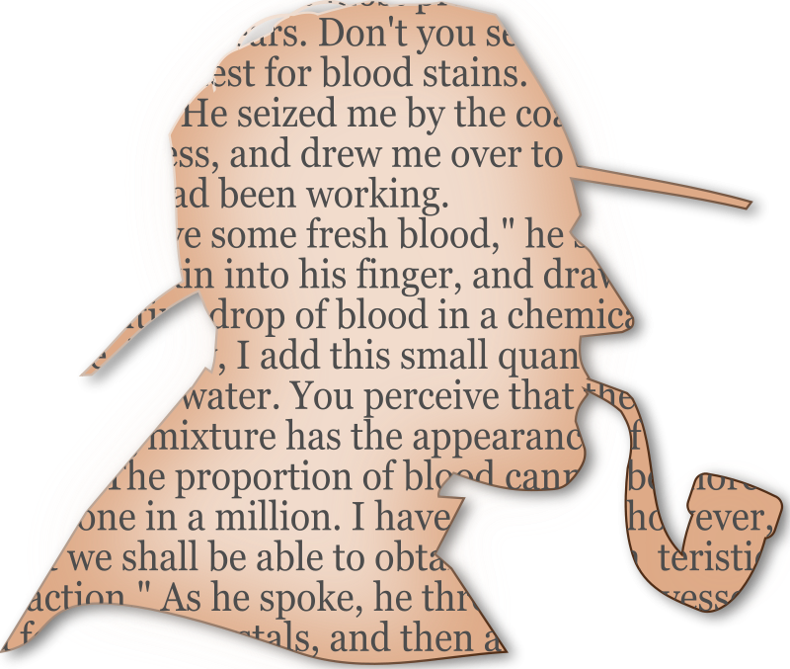
WHO ARE YOU?
?

Slide 4
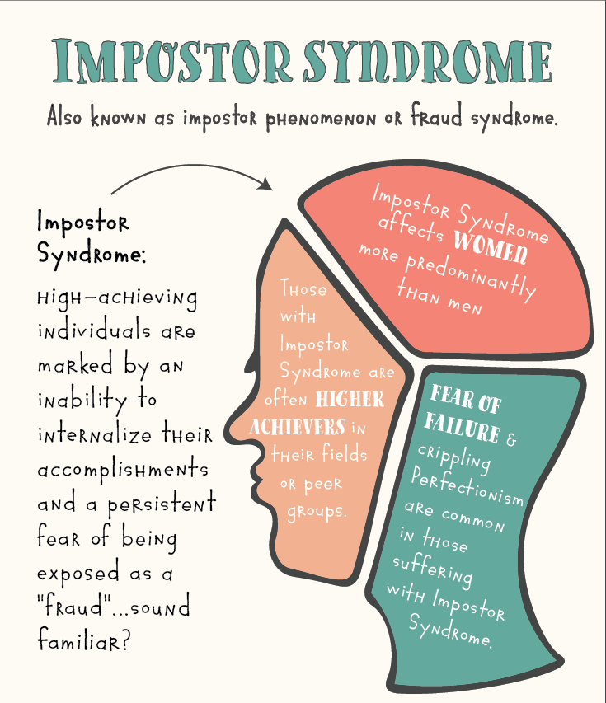
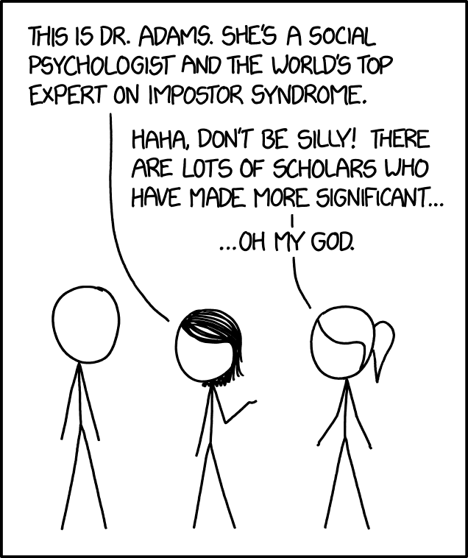
Notes:
If affects more to minorities, people who feel that they are not represented, that they do not belong to

Slide 5
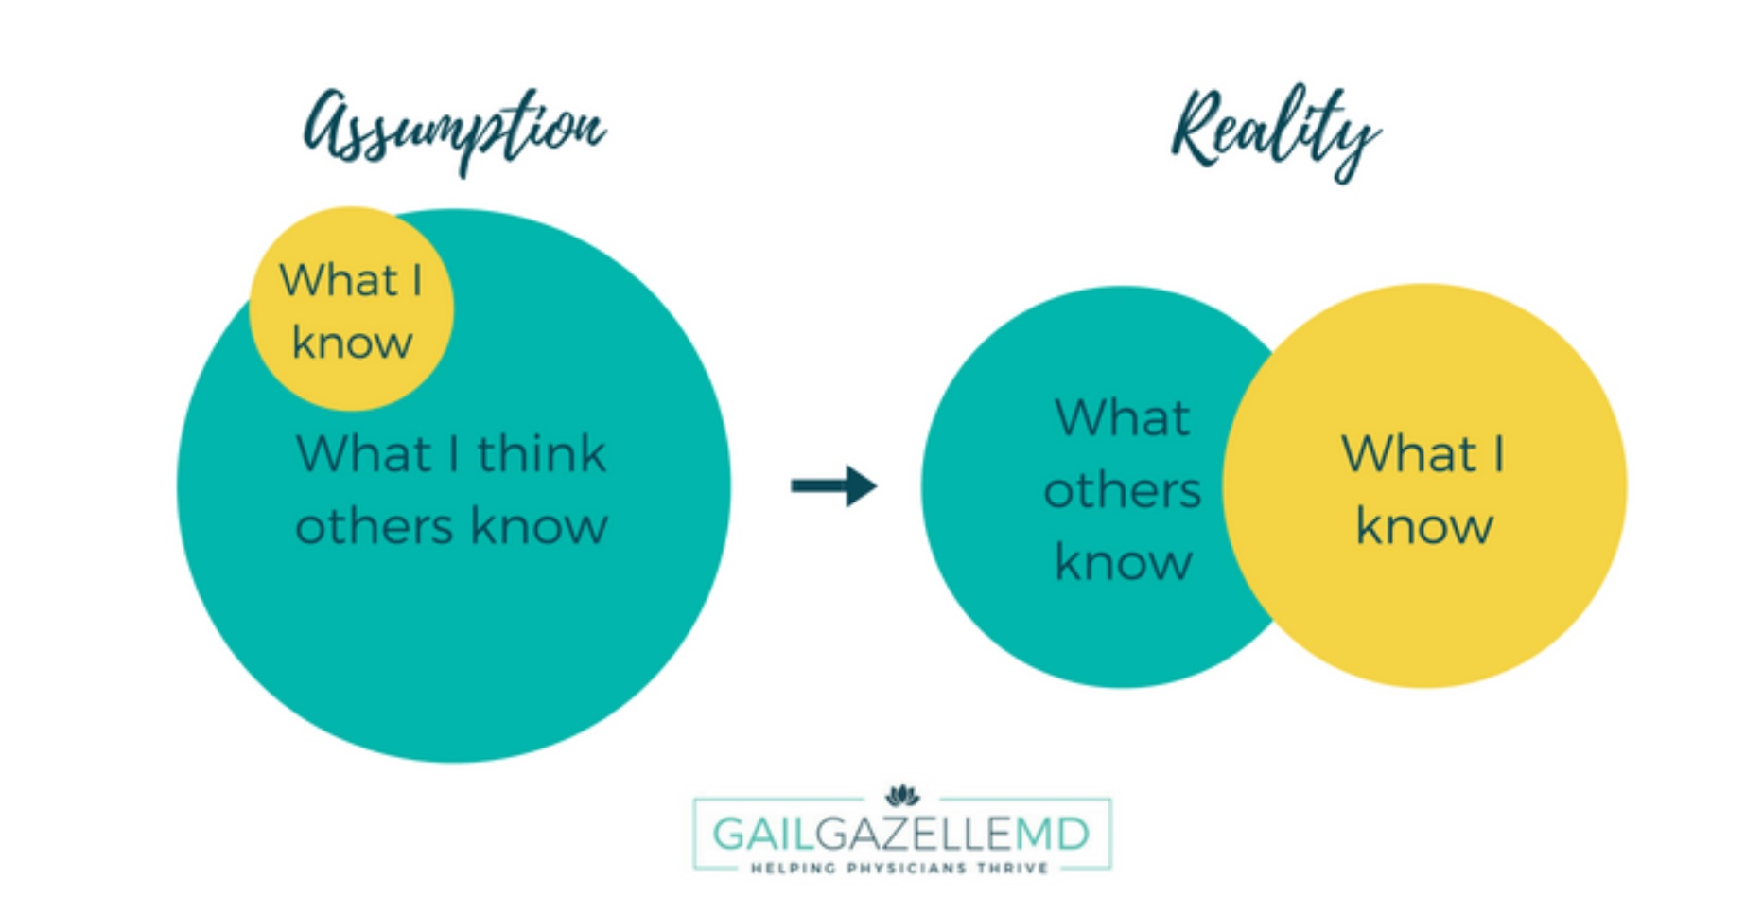
SYMPTOMS

Slide 6

MORE SYMPTOMS
You’re an over-worker.
You’re described as a perfectionist.
You avoid showing confidence
You focus more on what you haven’t done

Slide 7

TYPICAL IMPOSTOR THOUGHTS
You associate praise with charm over actual talent:
“He or she is lying”
“They don´t know what the hell they are talking about”
Notes:
The compliments are from someone who is lying
From nice relatives who dont know what the hell they are talking about

Slide 8
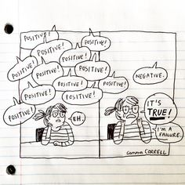
MORE THOUGHTS
“I am not good enough”
“They will find out that I don’t know most of the things”
“I am a fraud”
“I don’t belong here”
“I am not like them”
“I have no idea what I am doing”
...
More contributions??
Notes:
We have less satisfaction in our lives
We waste time over-preparing and worrying instead of doing good work and having fun
We are less effective as colleagues
We ask for less money
We don't ask for challenges
We don't ask for promotions or apply for jobs

Slide 9
CONSEQUENCES
We have less satisfaction in our lives
We waste time over-preparing and worrying instead of doing good work and having fun
We are less effective as colleagues, not as employees
We ask for less money
We don't ask for challenges
We don't ask for promotions or apply for jobs
...
Notes:
We have less satisfaction in our lives
We waste time over-preparing and worrying instead of doing good work and having fun
We are less effective as colleagues
We ask for less money
We don't ask for challenges
We don't ask for promotions or apply for jobs

Slide 10

WHY?
Perfection
Cognitive bias
Fear of failure
Stereotypes in society
Unconscious bias
Self-esteem
Minorities
https://implicit.harvard.edu/implicit/takeatest.html
Notes:
Cognitive bias: Individuals create their own "subjective social reality" from their perception of the input. Your brain takes incomplete and bad data and build wrong conclusions that you believe.
Expecting a member of a group to have certain characteristics without having actual information about that individual.

Slide 11
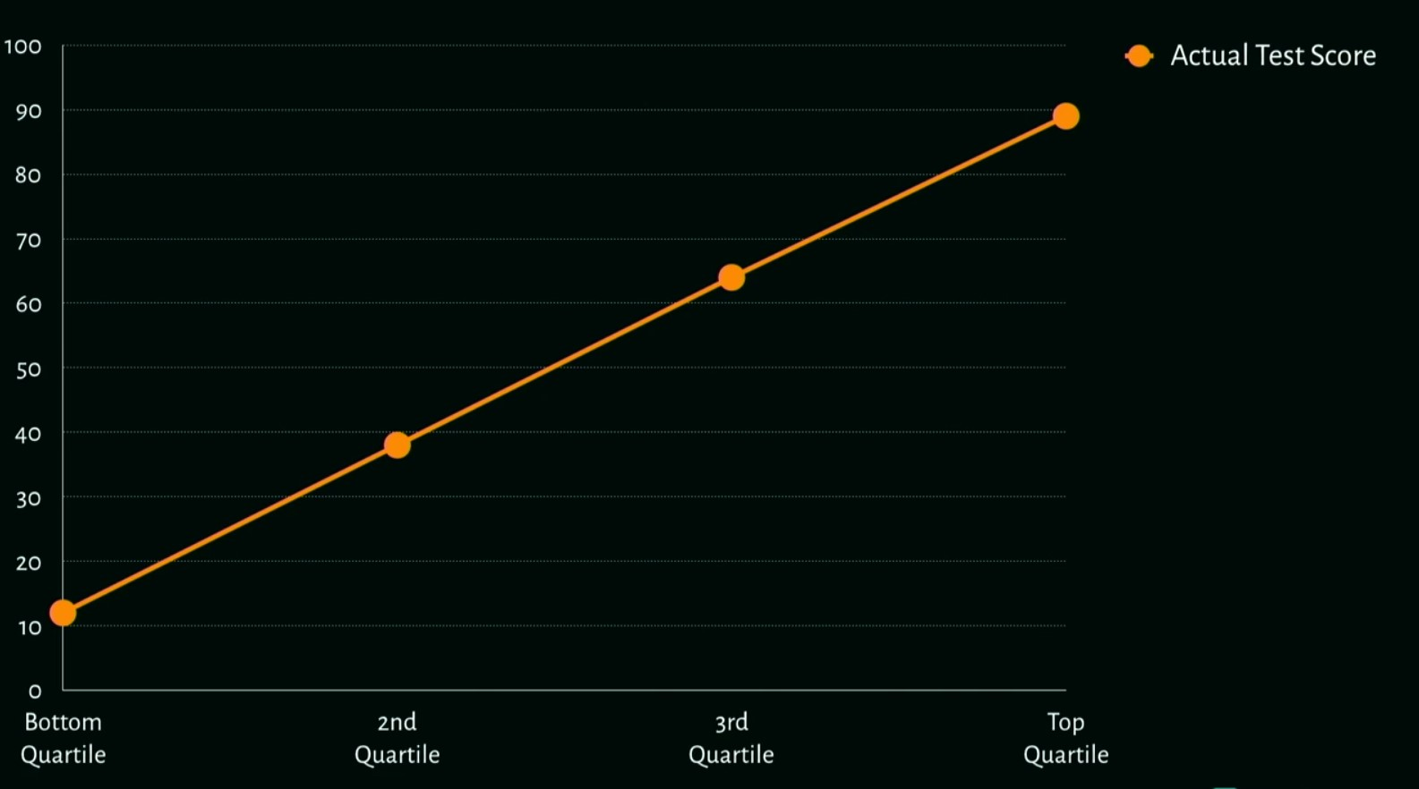
WHY?
Dunning–Kruger (1999)
Notes:
Also cultural reasons (japanese culture as an example)

Slide 12
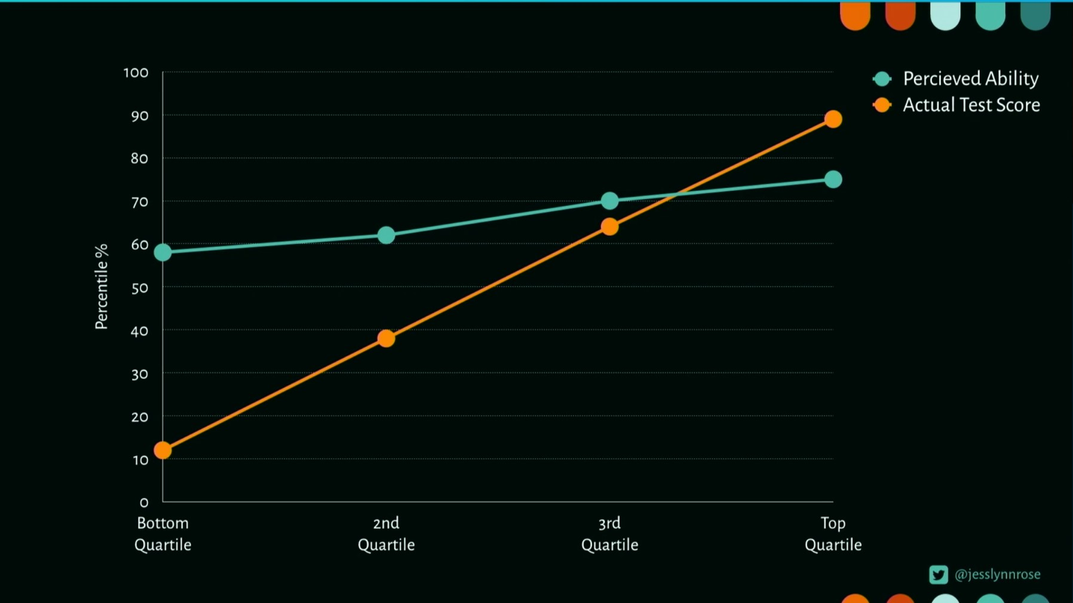
WHY?
Dunning–Kruger (1999)
Jessica Rose Conference
Notes:
Also cultural reasons (japanese culture as an example)

Slide 13
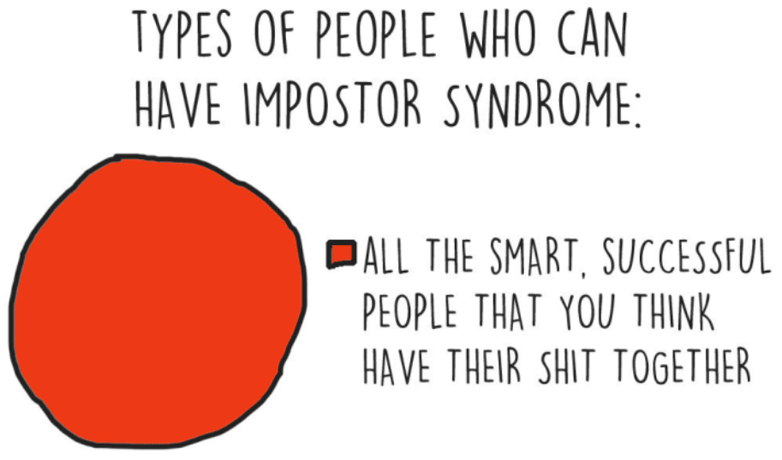
Notes:
Minorities, people who feel that they are not represented, that they are not like the others who are being successful (according to our cognitive bias)...

Slide 14
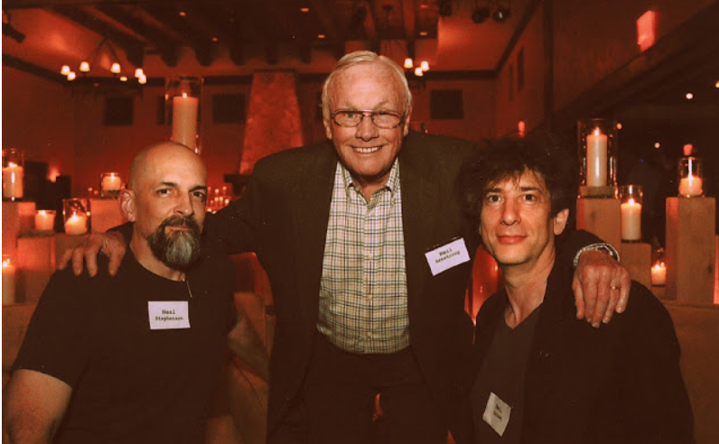
Neil Gaiman on Impostor Syndrome: http://neil-gaiman.tumblr.com/post/160603396711/hi-i-read-that-youve-dealt-with-with-impostor

Slide 15
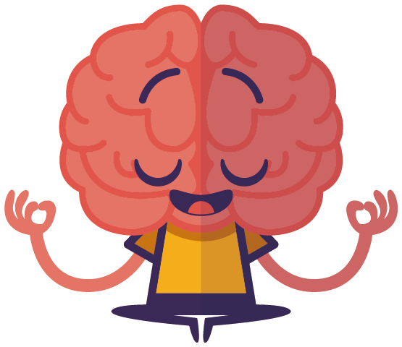

EXERCISE 1: TAKE A COMPLIMENT
“You are a good listener.“
“You work hard.“
“You did really great in the meeting.“
“I liked your input earlier, it gave us some good ideas.“
“Great idea in solving the bug.“
Notes:
10 MIN to write down and put the compliments on a wall
10 min to share experiences from the audience

Slide 16

EXERCISE 2: FIGHT NEGATIVE THOUGHTS
Notes:
Your brain is collecting bad data to build wrong conclusions and then become attached to it. Let’s reprogram our brains.

Slide 17
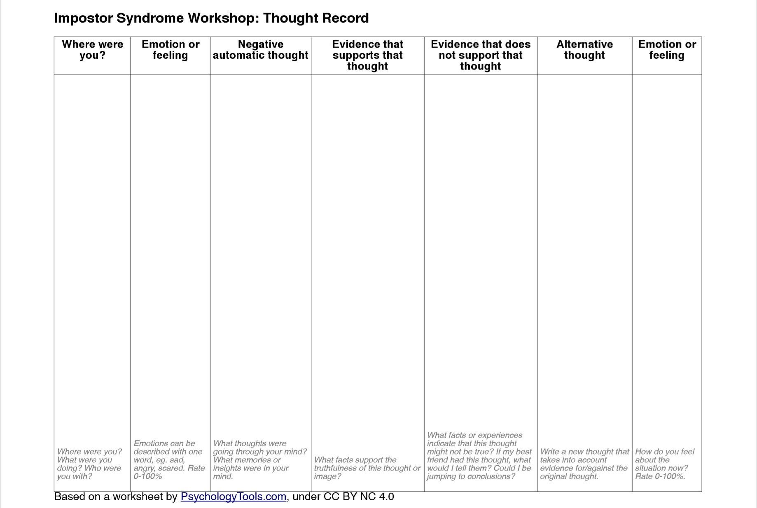
Notes:
Your brain is collecting bad data to build wrong conclusions and then become attached to it. Let’s reprogram our brains.

Slide 18

HOW TO DEAL WITH IT?
TALK AND SHARE
WATCH YOUR LANGUAGE
TEACH OTHERS
QUESTIONS? → ASK!
REQUEST FEEDBACK FROM FRIENDS
BELIEVE IN YOUR ACCOMPLISHMENTS
ACCEPT COMPLIMENTS
GET INVOLVED IN THE COMMUNITY
INCREASE DIVERSITY!!
Notes:
Talk about it and share your own failures
Watch your self-diminishing language (I’m just...)
Teach others what you know
Ask questions
Perspective check from a friend
List your accomplishments and own them
Practice accepting compliments
Talk to your colleagues and get the perspective of what is going on in the community/workplace

Slide 19

AND REMEMBER...
You are GREAT just the way you are!
Stop believing that lie that says we must be THE expert
Be proud of your Voice & accomplishments
You’re an important piece of the puzzle and…
…. you are NOT out there all ALONE!

Slide 20

RESOURCES...
Books:
“Life in Code” Ellen Ullman,
“La asertividad”, Olga Castanyer
Google Initiative:
https://iamremarkable.withgoogle.com/
Talk about impostor syndrome(@jesslynnrose) :
https://vimeo.com/287980808

Slide 21

Credits:
Denise Paolucci: “Overcoming Impostor Syndrome” (linux.conf.au 2013) Julie Pagano: “It's Dangerous to Go Alone” (PyCon 2014) Mood Gym: https://moodgym.anu.edu.au/welcome Slides, handout, guide for this workshop: http://adainitiative.org/continue-our-work/impostor-syndrome-training/
Timea Turdean (WTM Vienna)
Jessica Rose Talk

Slide 22

MANY THANKS!!
@rosacastilloPhD
arosacastillo@protonmail.com
www.linkedin.com/in/arosacastillo

